Slide 1
Assignment Tutorial Lesson of Digital Signal Processing

Slide 2
Content
Before This Lesson: Preparations;
Tutorials: Solutions of Assignment Problems;

Slide 3
Before This Lesson: Preparations
1.

Slide 4
Before This Lesson: Preparations
1.
You will NEED | Your assignments
 | A notebook
 | Attention & Patience
You will NOT NEED | Whisperings
 | Cellphones
 | Distractions

Slide 5
Solutions of Assignment Problems
2.

Slide 6
Solutions of 3rd Week Assignment
2.
2.3 Determine the even and odd parts of the following sequences:
Solution:
Likewise:
By using:

Slide 7
Solutions of 3rd Week Assignment
2.
2.6 Determine the conjugate symmetric and conjugate antisymmetric parts of the following sequences:
Solution:
By using:
Arrive at:

Slide 8
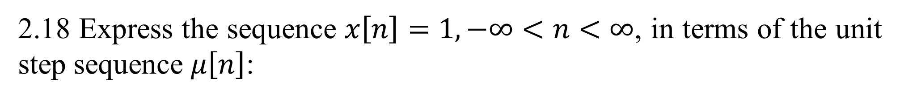
Solutions of 3rd Week Assignment
2.
2.18 Express the sequence $x\left[n\right]=1, −∞<n<∞$, in terms of the unit step sequence $μ\left[n\right]$:
Solution:
Thus:
Can be expressed in terms of the unit step sequence like:

Slide 9
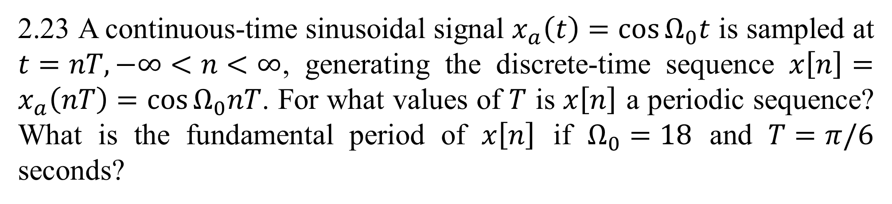
Solutions of 3rd Week Assignment
2.
2.23 A continuous-time sinusoidal signal $x_{a}\left(t\right)=\cos{Ω_{0}t}$ is sampled at $t=nT, −∞<n<∞$, generating the discrete-time sequence $x\left[n\right]=x_{a}\left(nT\right)=\cos{Ω_{0}nT}$. For what values of $T$ is $x\left[n\right]$ a periodic sequence? What is the fundamental period of $x\left[n\right]$ if $Ω_{0}=18$ and $T=π/6$ seconds?
Solution:
Assume N is the fundamental period of x[n]:

Slide 10
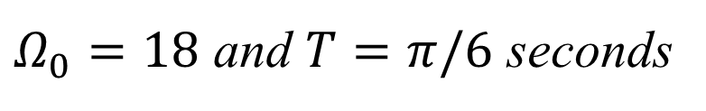
Solutions of 3rd Week Assignment
2.
2.23 A continuous-time sinusoidal signal $x_{a}\left(t\right)=\cos{Ω_{0}t}$ is sampled at $t=nT, −∞<n<∞$, generating the discrete-time sequence $x\left[n\right]=x_{a}\left(nT\right)=\cos{Ω_{0}nT}$. For what values of $T$ is $x\left[n\right]$ a periodic sequence? What is the fundamental period of $x\left[n\right]$ if $Ω_{0}=18$ and $T=π/6$ seconds?
Solution:
$Ω_{0}=18$ and $T=π/6$ seconds

Slide 11
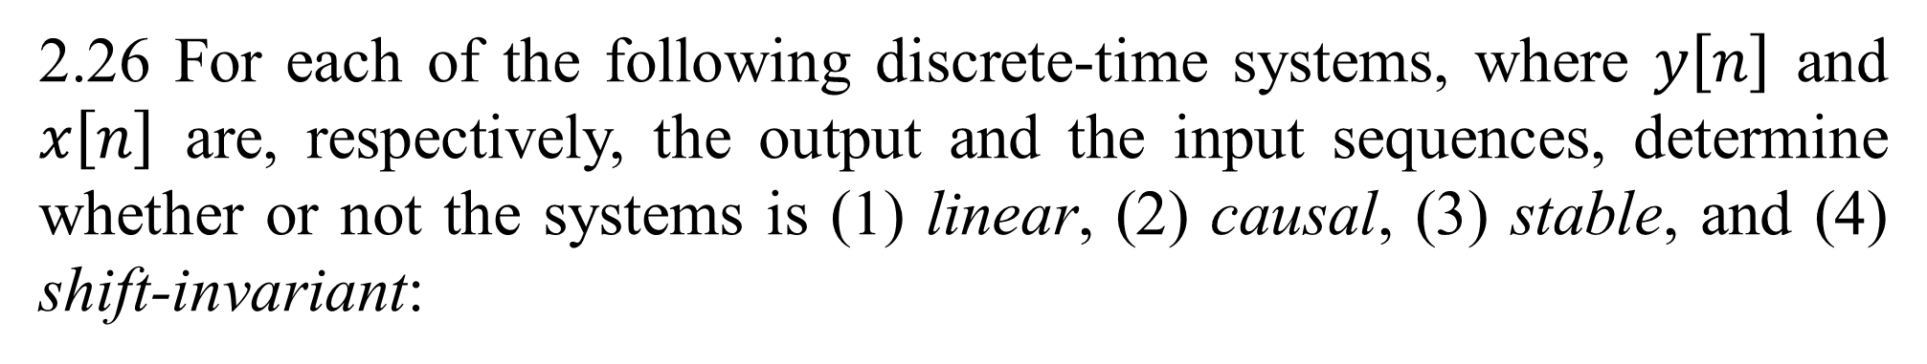
Solutions of 4th Week Assignment
2.
2.26 For each of the following discrete-time systems, where $y\left[n\right]$ and $x\left[n\right]$ are, respectively, the output and the input sequences, determine whether or not the systems is (1) linear, (2) causal, (3) stable, and (4) shift-invariant:
Solution:
Linearity:
Assume:
The output of x[n] is:
So, this is a linear system.

Slide 12
Solutions for 4th Week Assignment
2.
Solution:
Causality:
There is no output before the input. So, this is a Causal system.
Stability:
Assume:
The output of x[n] is:
So, this is an Unstable system.

Slide 13
Solutions for 4th Week Assignment
2.
Solution:
Shift-Invariance:
Assume:
The output of x₁[n] is:
Where:
So, this is a Shift-variant system.

Slide 14
Solutions of 4th Week Assignment
2.
2.26 For each of the following discrete-time systems, where $y\left[n\right]$ and $x\left[n\right]$ are, respectively, the output and the input sequences, determine whether or not the systems is (1) linear, (2) causal, (3) stable, and (4) shift-invariant:
Solution:
Linearity:
Assume:
The output of x[n] is:
So, this is a linear system.

Slide 15
Solutions for 4th Week Assignment
2.
Solution:
Causality:
There are outputs before inputs. So, this is a Non-causal system.
Stability:
Assume:
The output of x[n] is:
So, this is an Stable system.

Slide 16
Solutions for 4th Week Assignment
2.
Solution:
Shift-Invariance:
Assume:
The output of x₁[n] is:
Where:
So, this is a Shift-variant system.

Slide 17
Solutions of 4th Week Assignment
2.
2.26 For each of the following discrete-time systems, where $y\left[n\right]$ and $x\left[n\right]$ are, respectively, the output and the input sequences, determine whether or not the systems is (1) linear, (2) causal, (3) stable, and (4) shift-invariant:
Solution:
Linearity:
Assume:
The output of x[n] is:
So, this is a linear system.

Slide 18
Solutions for 4th Week Assignment
2.
Solution:
Causality:
There is no output before input. So, this is a Causal system.
Stability:
Assume:
The output of x[n] is:
So, this is an Stable system.

Slide 19
Solutions for 4th Week Assignment
2.
Solution:
Shift-Invariance:
Assume:
The output of x₁[n] is:
Where:
So, this is a Shift-invariant system.

Slide 20
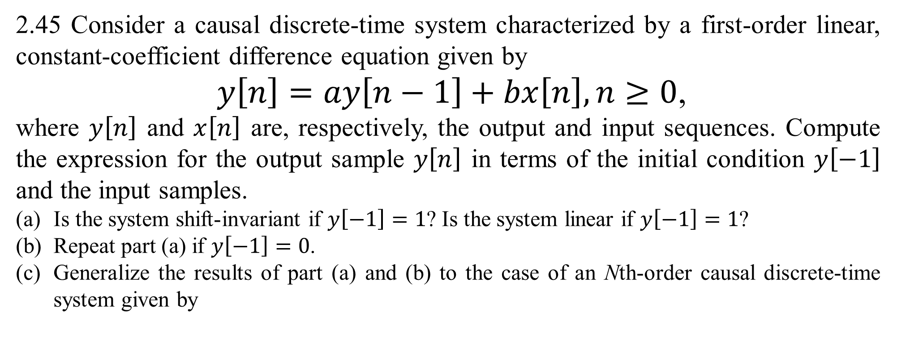
Solutions of 4th Week Assignment
2.
2.45 Consider a causal discrete-time system characterized by a first-order linear, constant-coefficient difference equation given by
$y\left[n\right]=ay\left[n−1\right]+bx\left[n\right], n≥0$,
where $y\left[n\right]$ and $x\left[n\right]$ are, respectively, the output and input sequences. Compute the expression for the output sample $y\left[n\right]$ in terms of the initial condition $y\left[−1\right]$ and the input samples.
Is the system shift-invariant if $y\left[−1\right]=1$? Is the system linear if $y\left[−1\right]=1$?
Repeat part (a) if $y\left[−1\right]=0$.
Generalize the results of part (a) and (b) to the case of an Nth-order causal discrete-time system given by

Slide 21
Solutions of 4th Week Assignment
2.
Solution:
By substituting the initial condition into the difference equation, we have:

Slide 22
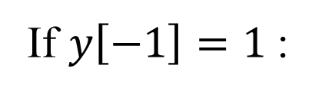
Solutions of 4th Week Assignment
2.
Is the system shift-invariant if $y\left[−1\right]=1$? Is the system linear if $y\left[−1\right]=1$?
Solution:
If $y\left[−1\right]=1$:
Assume:
So, this is a Shift-variant system.

Slide 23
Solutions of 4th Week Assignment
2.
Is the system shift-invariant if $y\left[−1\right]=1$? Is the system linear if $y\left[−1\right]=1$?
Solution:
If $y\left[−1\right]=1$:
Assume:
The output of x[n] is:
So, this is a Non-linear system.

Slide 24
Thank You!

